Slide 1
SPPS 255: Principles of Pharmacoeconomics
Propensity score matching
Monday, 05 May 2025

Slide 2
objectives
Brief introduction on the potential outcomes causal framework
Propensity score matching methods:
Nearest neighbor approach
Inverse probability weight (IPW) for average treatment effect (ATE)
Inverse probability weight (IPW) for average treatment effect of the treated (ATT)

Slide 3
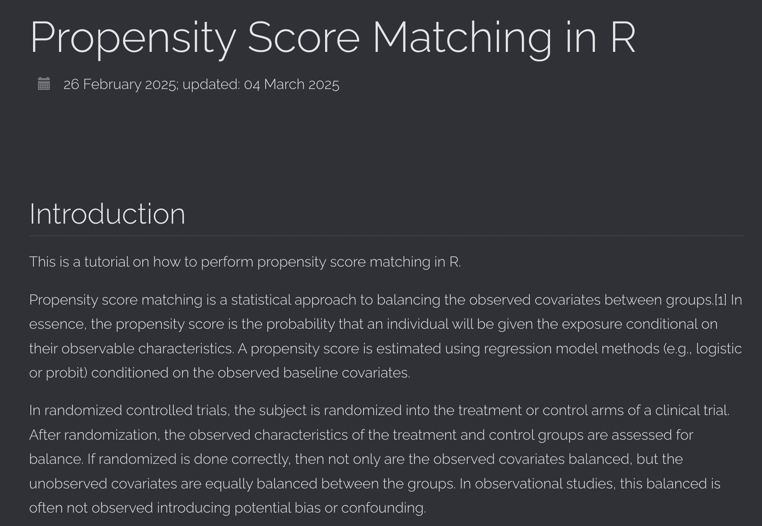
Another method to address confounding
Propensity score matching
(R Tutorial on propensity score matching methods)

Slide 4
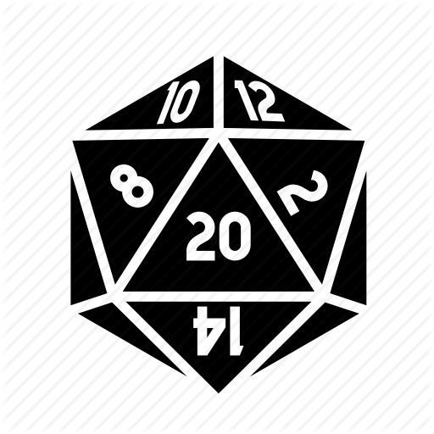



Potential outcomes causal model
Placeholder
Z = 1
$$Y_{i}(1)$$
Treatment = 1
$$Y_{i}\left(Y_{i}=Z_{i}Y_{i}\left(1\right)−(1−Z_{i}\right)Y_{i}(0))$$
Z = 0
$$Y_{i}(0)$$
Treatment = 0

Slide 5



ATE versus ATT
$$Y_{i}\left(Y_{i}=Z_{i}Y_{i}\left(1\right)−(1−Z_{i}\right)Y_{i}(0))$$
Average treatment effect (ATE): At the population-level, this is the difference between moving from one group to another (untreated to treated)
$$E[Y_{i}\left(1\right)−Y_{i}\left(0\right)]$$
Average treatment effect of the treated (ATT): Among those who receive the treatment, this is the difference between moving from one group to another (treated to untreated)
$$E[Y_{i}\left(1\right)−Y_{i}\left(0\right)|Z=1]$$

Slide 6

RCT versus observational studies
In an RCT the ATT = ATE due to randomization.
In an observational study, individuals who received treatment may be different than individual who are untreated.
$$E\left[Y\left(1\right)\right|Z=1]≠E[Y(1)$$
$$E\left[Y\left(0\right)\right|Z=0]≠E[Y(0)$$

Slide 7


Propensity score
Propensity score is the probability that an individual will receive treatment (e.g., balancing score)
First condition: Treatment assignment is independent of the potential outcomes conditional on the observed covariates
$$\left(Y\left(1\right), Y\left(0)\right)⊥⊥Z | X\right)$$
Second condition: Each individual has a non-zero probability of receiving the treatment condition on the observed covariates
$$0<P\left(Z=1 | X\right)<1$$

Slide 8
Nearest neighbor
You can get a n:1 match between the untreated and treated groups using a nearest neighbor matching strategy
Individuals have a propensity score that is used for matching
Caliper size determines the precision of the match (e.g., 0.01 size)
Lose a lot of data that are not matched

Slide 9


Inverse probability weights
Inverse probability weights maximize the sample size by assigning each individual a weight based on the propensity score
$${ipw}_{ATE}=\frac{Z_{i}}{{ps}_{i}}+\frac{(1−Z_{i})}{(1−{ps}_{i})}$$
IPW of the ATE:
$${ipw}_{ATT}=\frac{{{ps}_{i}Z}_{i}}{{ps}_{i}}+\frac{{ps}_{i}(1−Z_{i})}{(1−{ps}_{i})}$$
IPW of the ATT:

Slide 10

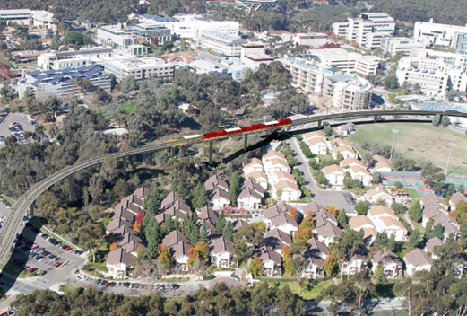
ADDITIONAL RESOURCES
Propensity score matching in R tutorial

